Slide 1
Harvesting Structured Summaries from Wikipedia and Large Text Corpora
University of California, Los Angeles
Computer Science Department
Hamid Mousavi
May 31, 2014

Slide 2













Curated Corpora
Many others
Notes:
They have mostly good English structure, thus easier to be interpreted by NLP parsers

Slide 3
The Future of the Web?
World Wide Web is dominated mostly by textual documents.
Semantic Web vision promises sophisticated applications, e.g.,
Semantic search or querying,
Question answering,
Data mining.
How?
Manual annotation of the Web documents,
and providing structured summary for them
Text mining is a more concrete and promising solution:
By automatically generating Structured Summaries
By providing more advanced tools for crowdsourcing
Notes:
According to the W3C, "The Semantic Web provides a common framework that allows data to be shared and reused across application, enterprise, and community boundaries.”
Our Goals:
Integrating available structured knowledge bases (KBs)
Completing it by extracting more structured data from unstructured (Text) and semi-structured part of web
Providing user friendly ways to query the KB

Slide 4
Structured Summaries
Notes:
Move to after tha

Slide 5
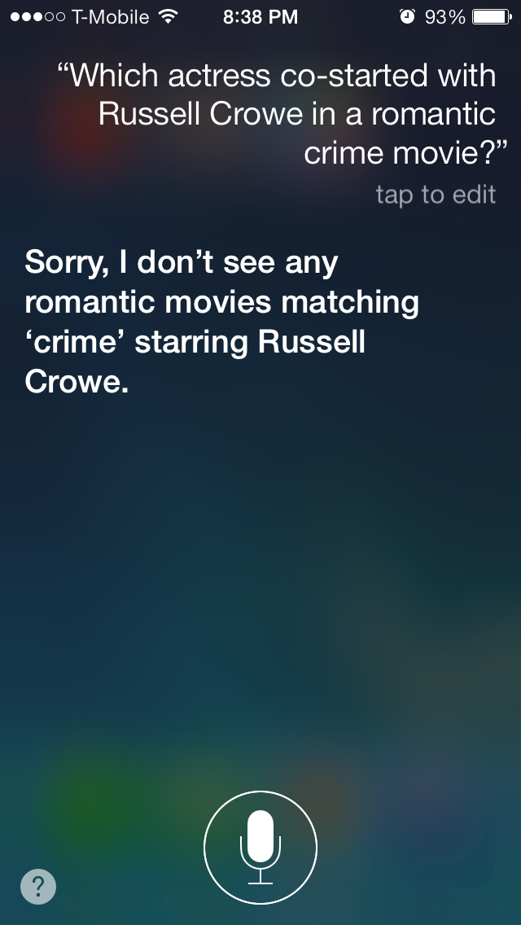
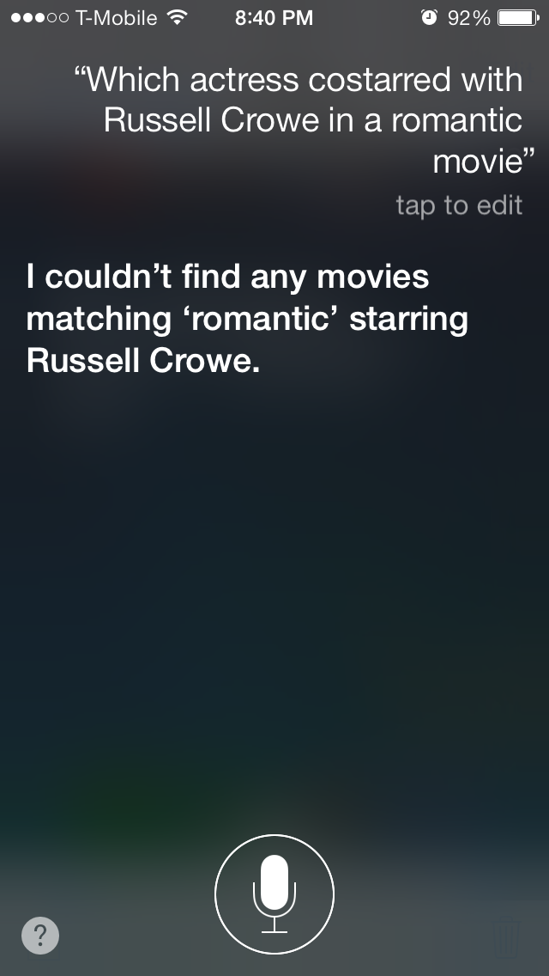
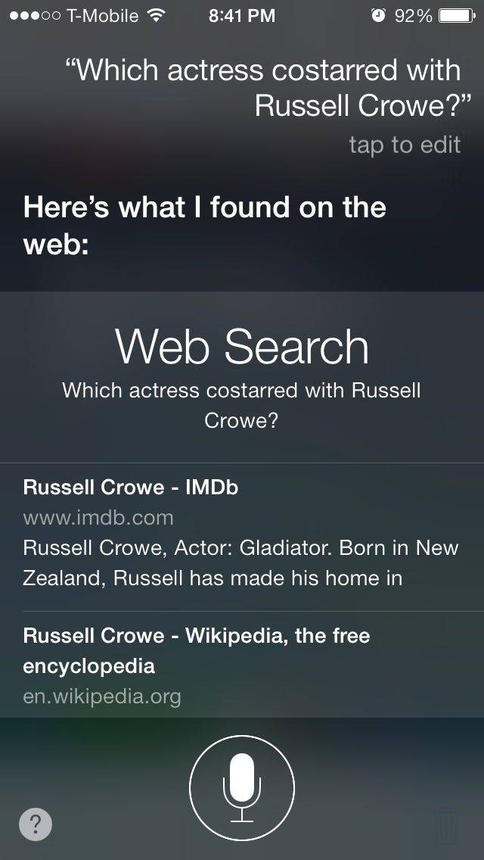
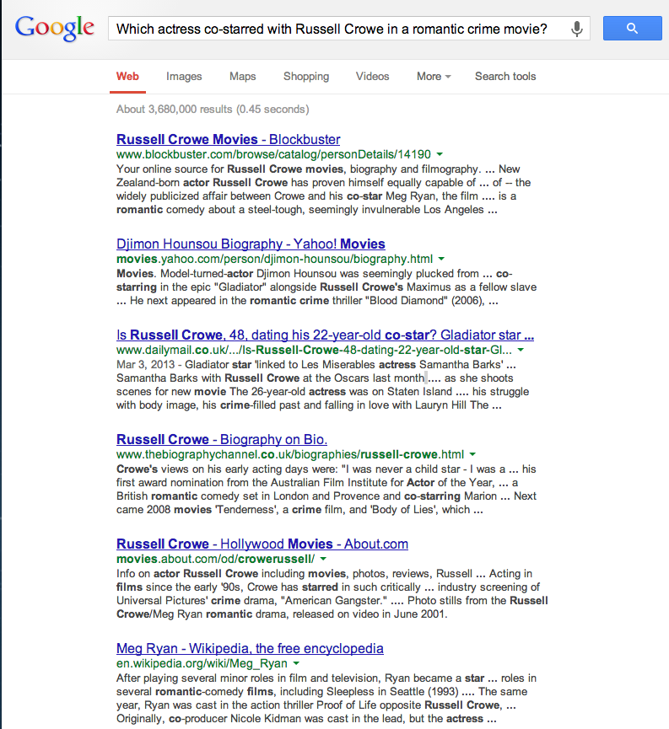
Querying Structured Summaries
Query: Which actress has co-starred with Russell Crowe in a romantic crime movie?

Slide 6
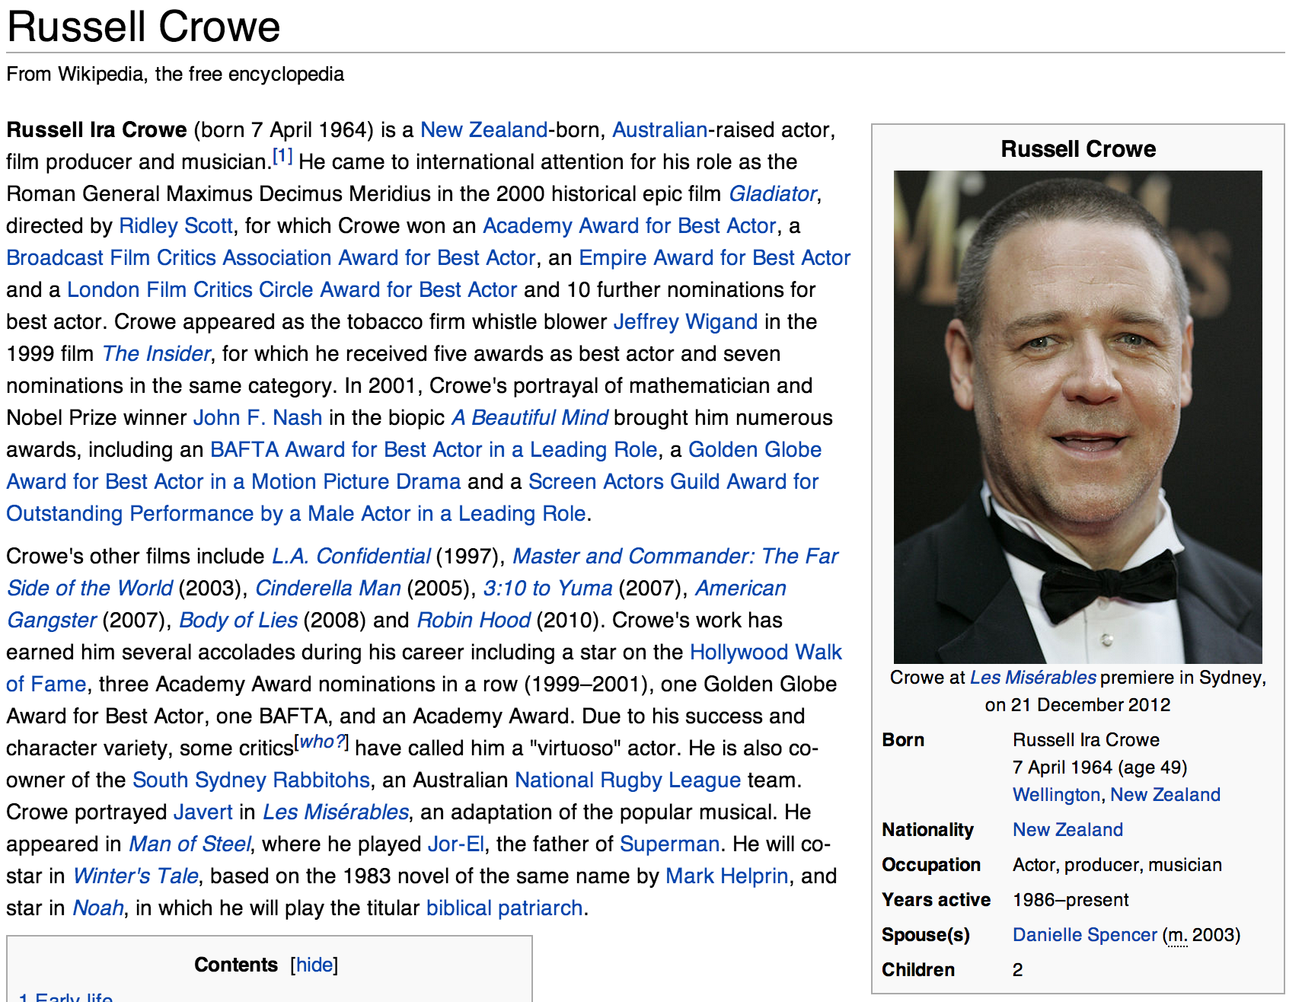
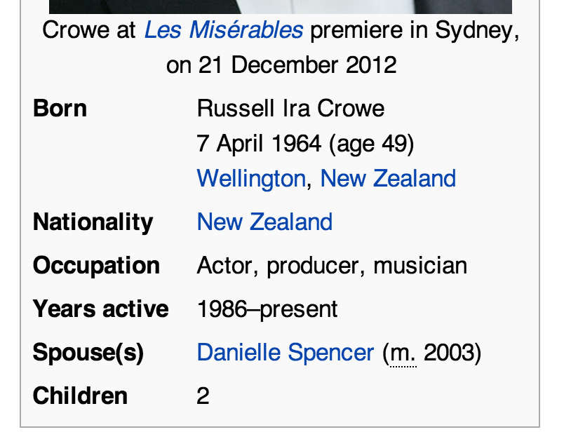
Structured Summaries can help …

Slide 7
Semantic Search through structured queries
After converting InfoBoxes (and similar structured summaries) into RDF triples formats,
subject/attribute/value
we can use SPARQL to perform a semantic search:
SELECT ?actress
WHERE {
?actress gender female.
?actress actedIn ?movie.
“Russell Crowe” actedIn ?movie.
?movie genre “crime”.
?movie genre “romantic” }
Notes:
Crime thriller might be the genre of the movie and since crime thriller is type of crime it should be part of the answer.
BESTQ we are biased toward since designed by Prof. and provide sharper queries

Slide 8
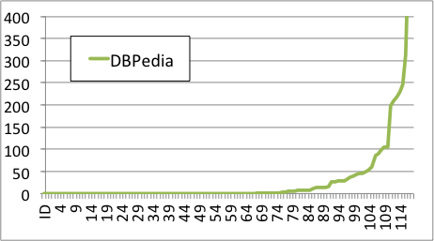
Challenge 1: Incompleteness
Large datasets, but still incomplete
E.g. DBpedia is unable of finding any result for more that half of the most popular queries in Google
Big portion of DBpedia is not appropriated for structures search
The number of results found in DBpedia for 120 most popular queries about musicians and actors.
Notes:
Only 20% of DBpedia is good for structured search.
That part is mostly provided by Wikidata as well.

Slide 9
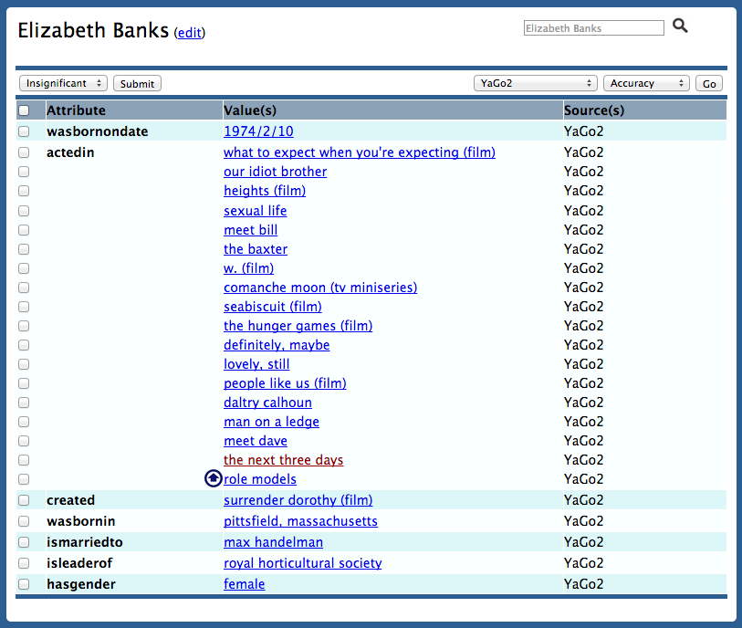
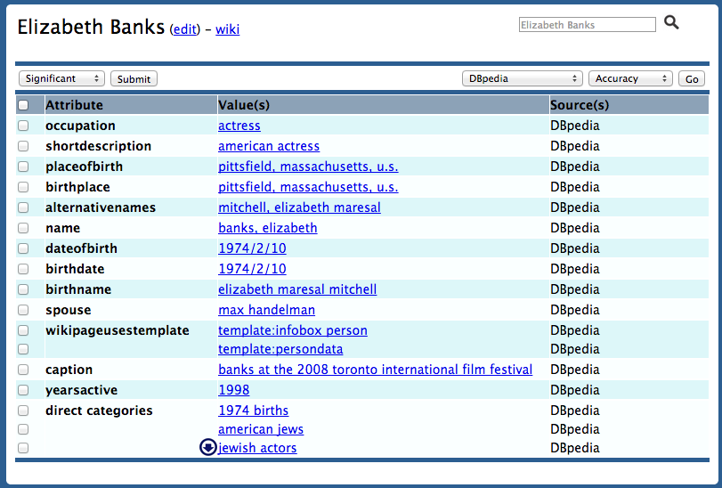
Challenge II: Inconsistency
YaGo2
DBpedia

Slide 10
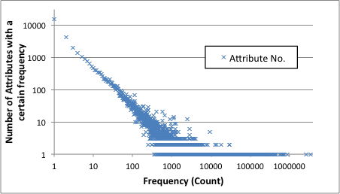
Inconsistency - Attributes
DBpedia introduces 44K attribute or property names.
Title
0.9 million (1.6%)
name
2.6 million (4.8%)
wikiPageUsesTemplate
3.5 million (6.5%)
27K of attributes are observed only less than 10 times
36K of attributes are observed only less than 100 times

Slide 11
Harvesting from Free Text
Notes:
Move to after tha

Slide 12
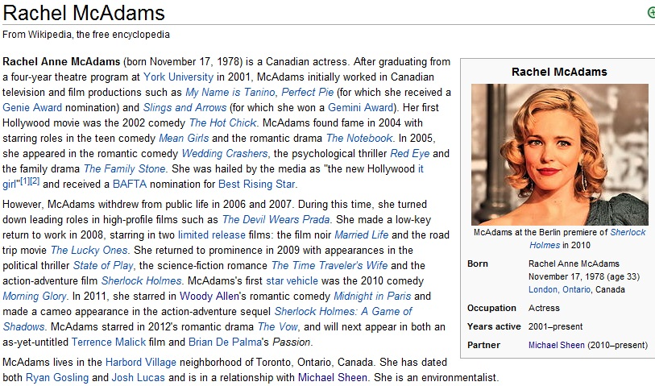
Example: Wikipedia

Slide 13
Our Systems: (Quick overview)
Textual data:
IBminer: Mining structured Summaries from free text
Based on the SemScape text mining framework
CS³: Context-aware Synonym Suggestion System
OntoMiner (OntoHarvester): Ontologies generation from free text
IKBstore: Integrating data sets of heterogeneous structures
IBE: Tools the crowdsourcing support
Notes:
Combination of Sampling with existing Techniques (Feature)

Slide 14
Generating Structured Summaries From Text
IBminer:
Step a: uses our previously developed text mining framework to convert text to graph structure called TextGraphs,
Step b: utilizes a pattern based technique to extract Semantic Links from the TextGraphs, and
Step c: learns patterns from existing example to convert the extracted information into the correct format in the current knowledge bases
Step d: Generates final triples from the learnt patterns
Notes:
Very time-consuming and resource demanding
Only for Wikipedia’s Text, we generate more than 50 Trillion intermediate recodes

Slide 15
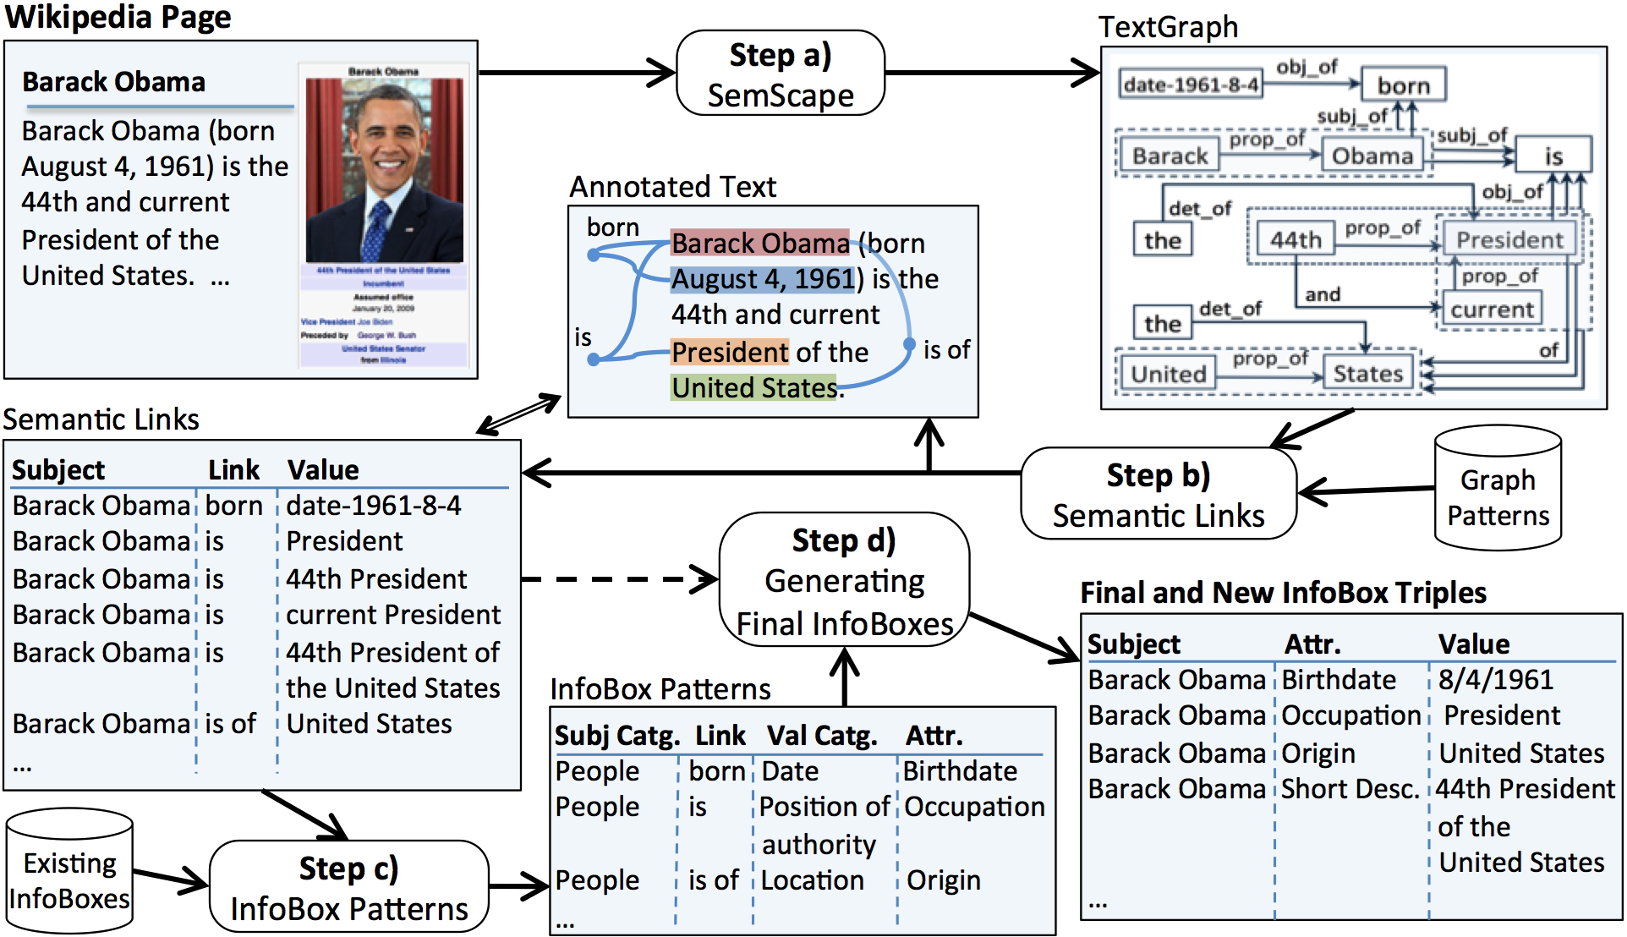
IBminer - Example

Slide 16
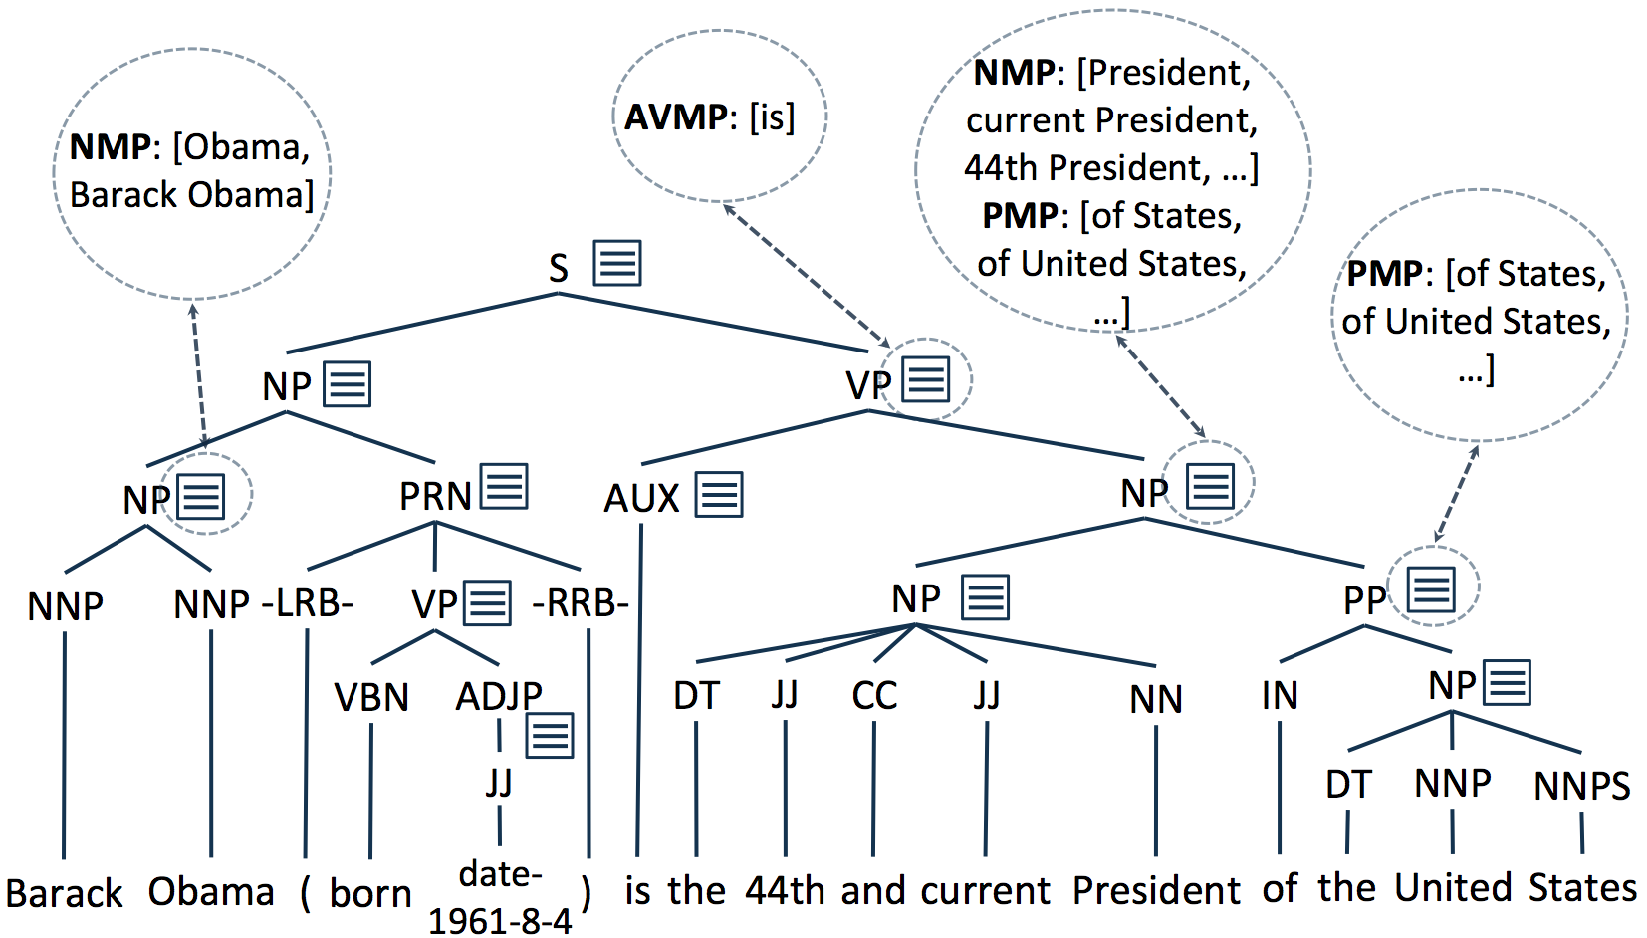
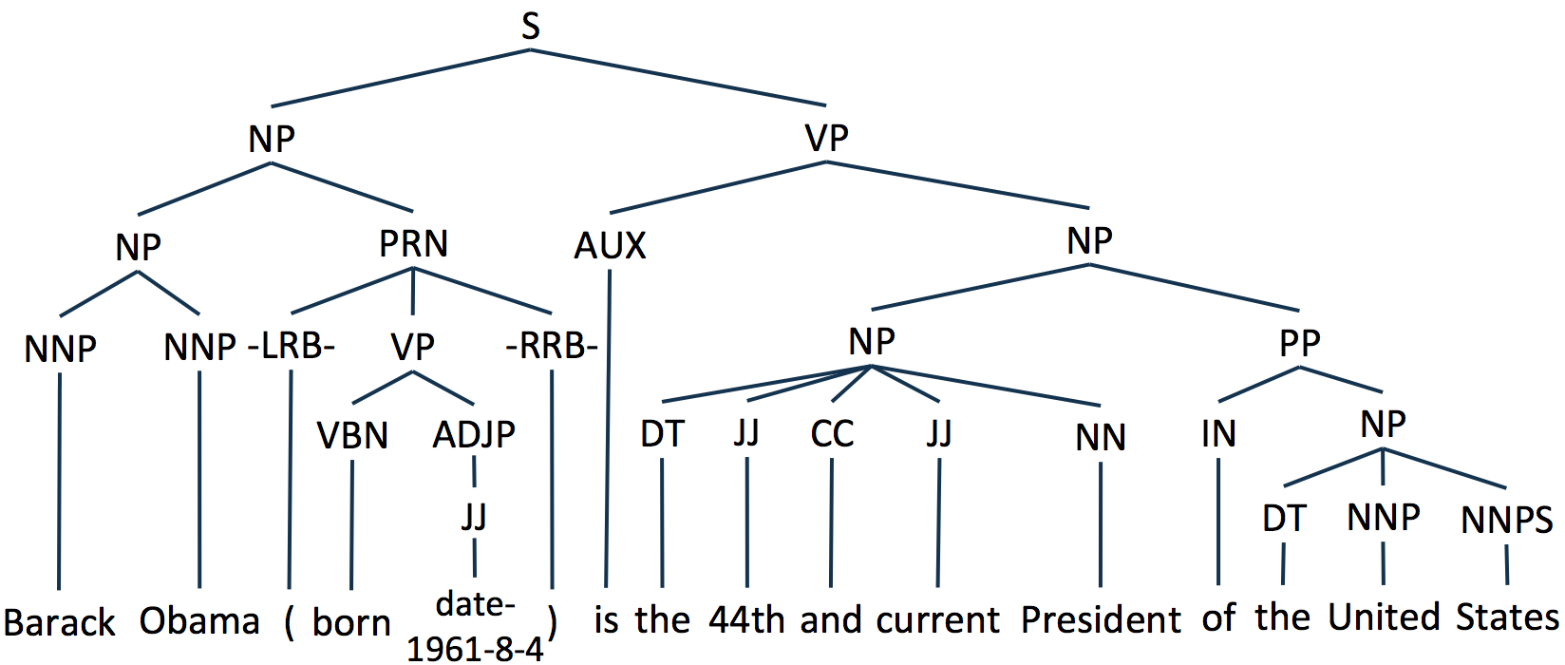
Step a: From Text to TextGraphs
President,
Current President
44th President
Notes:
Mention that we user parser by the main contribution is Text graphs or something

Slide 17
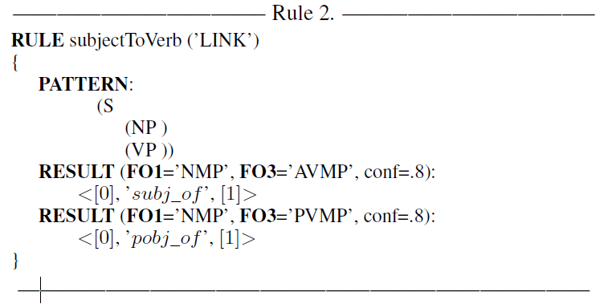
Generating Grammatical Relations
Grammatical Relations
Subject Link Value
Obama subj_of is
Barack Obama subj_of is
…

Slide 18
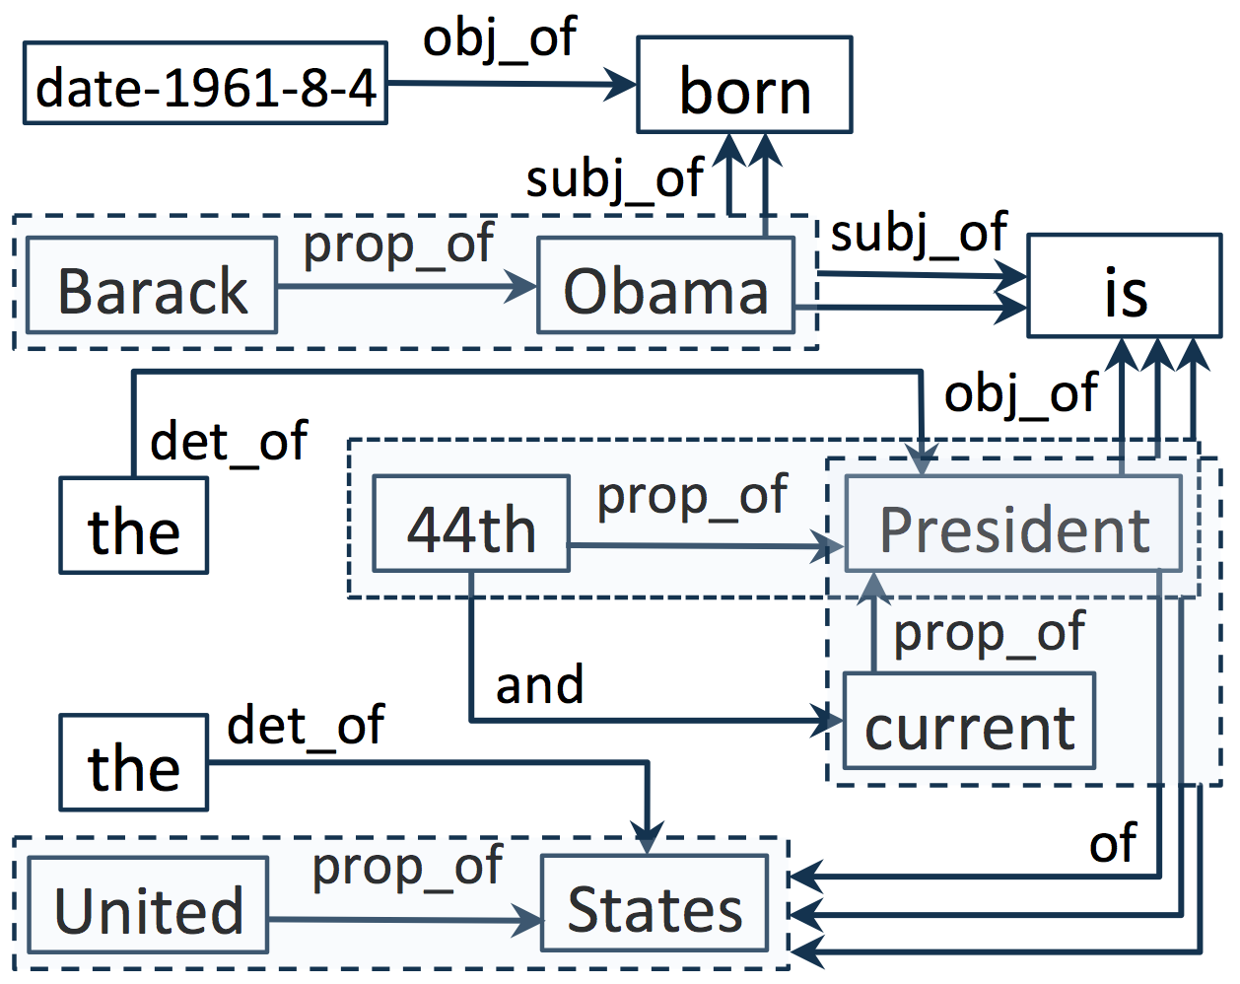
TextGraphs
Notes:
Putting all relations together

Slide 19
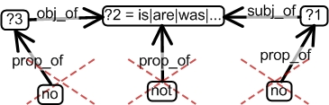
Step b: Generating the Semantic Links
Graph Domain Patterns
Semantic Links
Subject Link Value
Barack Obama be President
Barack Obama be 44th President
Barack Obama be current President
Barack Obama be 44th President of
the United States
…

Slide 20
Step c: Learn the Potential Maps
Semantic Links
Existing InfoBox Triple
<G.W. Bush, be, president>
<Nelson Mandela, be, president>
<Bill Clinton, be, president>
<G.W. Bush, Occupation, president>
<Nelson Mandela, Occupation, president>
<Bill Clinton, Occupation, president>
<Cat:Person,
be,
Cat:PositionsOfAuthority>:
Occupation
<Cat:Politician, be, Cat:PositionsOfAuthority>: Occupation
Potential Maps (PMs)
Notes:
Mention Categorical information is provided by Wikipedia as well.

Slide 21
Step d: Generates final triples
Semantic Links
PM patterns
<Barack Obama, be, president>
<Cat:People, be, Cat:PosOfAuthority>: Occupation
<Cat:Politician, be, Cat:PosOfAuthority>: Occupation
…
<Cat:People, be, Cat:PosOfAuthority>: Title
<Cat:Politician, be, Cat:PosOfAuthority>: Title
…
Cat:People
Cat:Politician
…
Cat:PosOfAuthority
…
Potential Interpretations/Maps:
<Barack Obama, Occupation, president> → freq = 248
<Barack Obama, Title, president> → freq = 109
<Barack Obama, Description, president> → freq = 173
<Barack Obama, PlaceOfBirth, president> → freq = 25
Best Match
Secondary Match
Type mismatch

Slide 22
IMPROVING CONSISTENCY OF THE STRUCTURED SUMMARIES
Context-Aware Synonym Suggestion System

Slide 23
Context-aware Synonyms
Users use many synonyms for the same concept
<J.S.Bach, birthdate, 1685-03-31>
<J.S.Bach, dateofbirth, Eisenach>
Or even use the same term for different concepts
<J.S.Bach, born, 1685-03-31>
<J.S.Bach, born, Eisenach>
For us, it’s easy to say that the former “born” means “birthdate” and the latter means the “birthplace”.
Since we know the context of values “1685-03-31” and “Eisenach”. One is a date but the other is a place.
We refer to these sort of information as contextual information.
Such information is [partially] provided by categorical information in different KBs. (e.g. Wikipedia).
Notes:
Attributes may have several meanings based on the context.
We use categorical information provided by Wikipedia as contextual information to find the best synonym for a vague attribute.

Slide 24
CS³ – Main Idea …
CS³ learns context-aware synonyms by the existing examples in the initial IKBstore.
Consider the below triples from existing KBs:
<W.A. Mozart, born, 1757-01-27>
<W.A. Mozart, birthdate, 1757-01-27>
This suggests a possible synonym (born and birthdate)
When they are used between a person context and a date context.
Thus, we learn following potential context-aware synonyms:
<cat:Person, born, cat:date>: birthdate
<cat:Person, birthdate, cat:date>: born
We also store the frequency for this match indicating how many times it was observed.

Slide 25
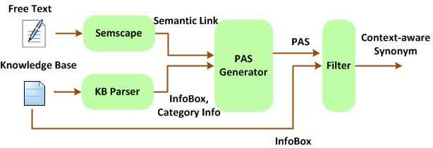
Potential Attribute Synonyms (PAS)
The collection of all the aforementioned Potential Attribute Synonyms is called PAS.
PAS is generated by a one-pass algorithm that learns from:
Existing matches in current KBs
Multiple matching results from the IBminer system
Notes:
The intuition behind using the results of Ibminer (In addition to the matches in the KBs) is that if two attributes are synonyms they should be presented with similar morphological constructs in the text.

Slide 26
Results

Slide 27
Evaluation Settings
We used the 99% of text in all Wikipedia pages
Max 200 sentence from pages
Converting text to TextGraph (Step a) and generating Semantic Links (Step b):
UCLA’s Hoffman2 cluster (average 100 cores each with 8GB Ram)
More than 4.5 Billion Semantic Links
Took a month
Using only those semantic links for which the subject part matches the page title we performed (Step c).
64-core machine with 256GB Memory
251 Million links
8.2 Million matching links with exiting IBs
More than 67.3 Million PM patterns (not considering low frequent ones)

Slide 28
Evaluation Strategy
Semantic Links
Existing Summaries (Ti)
Tm
New Summaries
not covered in text

Slide 29
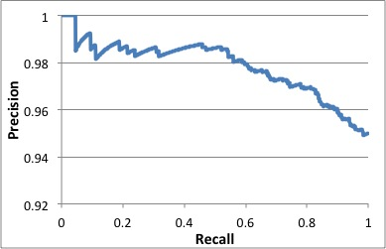
Evaluation of attribute mapping
Consider generated triples, say <s, a, v>, for which there exist a triple <s, a’, v> in the initial KB.

Slide 30
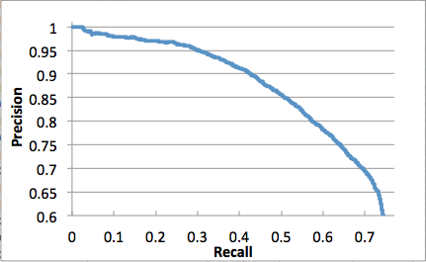
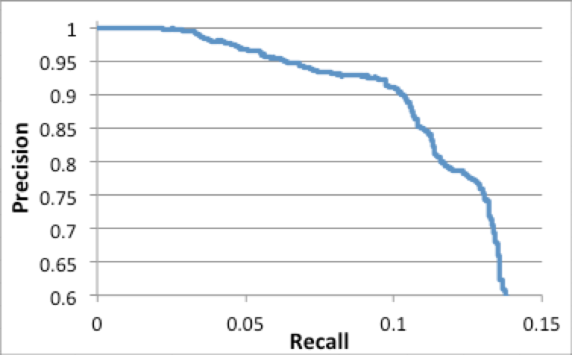
The evaluation of final results by IBminer
Precision/Recall
best matches
Precision/Recall
secondary matches
3.92 Million Correct Triples (Best)
3.2 Million Correct Triples (Secondary)
Notes:
The diagram on the left shows the additional improvement in the coverage of the results once the secondary matches are also conspired. (secondary matches can be seen as synonyms).
Secondary matches: In the process of generating structured from text, we first create subject-link-value from text using semscape. Then we try to match the link to one or more attribute names (encountered so far in the existing KBs.) At this point IBminer may find more than one good matches. The first or best match is always accepted (shown in the left diagram). But the other matches (called secondary matches) are accepted if there is some evidence that they are synonyms for the first/best match. (As for evidence here we use PAS as well)
The coverage in the secondary matches are computed based on the existing synonyms in the current KB which are very few and scattered.
Although the coverage shows only few percent improvement (in diagram on the right), we are finding considerable number of synonymous matches. The number of correct synonymous matches is more than half the number of best matches.

Slide 31
Why this is impressive?
Most of these pieces are not extractable with any of non-NLP based techniques
There is a small overlap between InfoBoxes and the text.
Many numeric values in InfoBoxes (e.g. weight, longitude)
Many list information (e.g. list of movies for an actor)
Many pages do not provide any useful text
42% of pages do not have acceptable text
This implies 2.7 new triples per page
12.2 M triples in Wikipedia’s is around
58.2% improvement in size
Up to1.6 Million new triples for around 400K subjects with no structured summaries.
These subjects now at least have a chance to be shown up in some search results
Notes:
If we define high quality pages as those with more than 4 sentences in them we totally generate 4.86 million triples for 2.76 million pages which is around 1.78 triple per page
Acceptable Text: should have at least one sematic links from it.

Slide 32
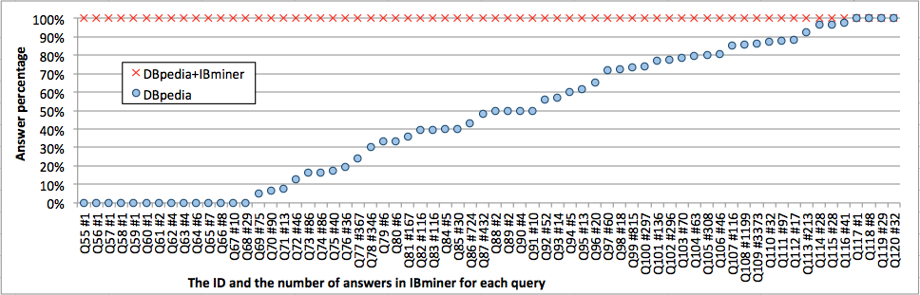
Improvement in structured search results
120 most popular queries are generated from Google Autocomplete System and converted to SPARQL.
We provide the answers for these queries using
Original DBpedia and
IKBstore
We improve DBpedia by at least 53.3%. (only using abstracts)
Notes:
We improve the DBpedia’s size by at least 25%, but it would be very hard to interpret this improvement only with recall number

Slide 33
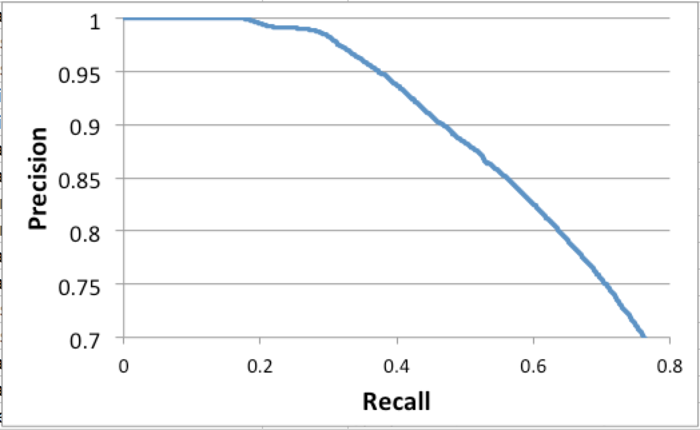
Running CS³
We ran CS³ over the exiting summaries:
~6.8 Million PAS patterns from existing KBs
~81.7 Million PAS patterns from common Potential Maps
7.5 million synonymous triples (with accuracy of 90%)
4.3 new synonymous triples
Notes:
The rest can be used for provenance and confidence

Slide 34
Thank you Carlo and Happy Birthday
Questions?

Slide 35
Extra Slides

Slide 36
Integrated Knowledge Base (IKBSotre)
Putting all together

Slide 37












Other sources of structured summaries
The MIMIC II Database
Notes:
The Wikipedia people are well aware of these problems and also of the fact that the mapping from infoboxes to Wikipedia is often ad-hoc and frequently inconsistent.
Now with the help of Google, they have launched Wikidata to remove these inconsistencies and provide multilingual support.

Slide 38
IKBstore
Task A) Integrating several knowledge bases
Considering Wikidata as the starting point
Task B) Resolving inconsistencies
Through CS³
Task C) More structured summaries from text,
By adding those IBminer generated
Task D) Facilitating crowdsourcing to revise the structured summaries
By allowing users to enter their knowledge in text

Slide 39
Task A: Initial integration
Integrating the following structured summaries
We also store the provenance of each triple
Name | # of Entities (10⁶) | # of Triples (10⁶)
ConceptNet | 0.30 | 1.6
Dbpedia | 4.4 | 55**
Geonames | 8.3* | 90
MusicBrainz | 18.3* | 131
NELL | 4.34* | 50
OpenCyc | 0.24 | 2.1
YaGo2 | 2.64 | 124
WikiData | 4.4 | 12.2
*Only those which has a corresponding subject in wikipedia are added for now
*This is only the InfoBox-like triples in DBpedia

Slide 40
Task B: Inconsistencies & Synonyms
In order to eliminate duplication, align attributes, and reduce inconsistency of the initial KB we use the Context-aware Synonym Suggestion System (CS3)
The initial KB is expanded with more frequently used attribute names.
This often results in entities and categories being merged.
4.3 synonymous triples will be added to the system after this phase

Slide 41
Task C: Completing our KB/DB
Completing the integrated KB/DB by extracting more facts From free text.
Using the IBminer presented earlier.
Currently the text are imported from the Wikipedia pages.
As mention this will add about 5 million more triples to the system

Slide 42
Task D: Reviewing & Revising
IBminer and other tools are automatic and scalable—even when NLP is required.
But human intervention is still required
Current mechanisms are wasting users time since the need to perform low level task
This task, which is recently presented at VLDB 2013 demo, supports the following features:
The InfoBox Knowledge-Base Browser (IBKB) which shows structured summaries and their provenance.
https://www.youtube.com/watch?v=kAdI-0nf_WU
The InfoBox Editor (IBE), which enables the users to review and revise the exiting KB without requiring to know its internal structure.
https://www.youtube.com/watch?v=dshkbM0AOag

Slide 43
Tools for Crowdsourcing
Suggesting missing attribute names for subjects, so users can fill the missing values.
Suggesting missing categories
Enabling users to provide feedback on correctness, importance, and relevance of each piece of information.
Enabling users to insert their knowledge in free text (e.g, by cutting and pasting text from Wikipedia and other authorities), and employing IBminer to convert them into the structured information.

Slide 44
Conclusion
In this work, we proposed a general solution for integrating and improving structured summaries from heterogeneous data sets:
Generating structured summaries from text
Generating structured summaries from semi-structured data
Reconciling among different terminologies through synonym suggestion system.
Providing smarter crowdsourcing tools for revising and improving the KB by the users
Name | Subjects | Subjects with IB | IB triples | Synonyms triples
DBpedia | 4.4 M | 2.9 M | 55M | ?
Initial KB | 4.4 M | ~2.9 M | 51.5M | 6.1 M
IKBstore | 4.4 M | 3.3 M(13.7%) | 60.8M (18%) | 10.4M (70.5%)

Slide 45
Structured querying
More Slides On

Slide 46
By-Example Structured Query (BESt)
Users provide their query in a by-example-query fashion, that is:
They find a similar page for their seeking subject
Then they use the given structure as a template to provide their query by selecting attribute/values they care about.
The approach also supports queries requiring a join operation. e.g. our running example.
Notes:
Change the example to the one in the proposal

Slide 47
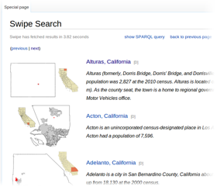
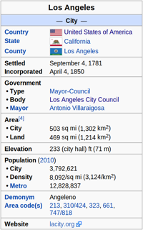
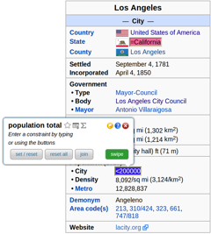
BEStQ - Example
Back

Slide 48
Search by Natural Language
Expressing queries with Natural Languages is another interesting solution.
Naïve versions of this idea is already implemented in
Facebook’s graph search
Siri
Google Now
The general idea is:
To convert the query to the structured form using an IBminer-like technique (A text mining approach explained later),
Expand the structured form with ontological and contextual information,
Construct the final structured query, and
Run the query on the knowledge base.
Notes:
Extra slide

Slide 49
Combining structured and keyword queries
There are many cases that part of a query can be presented by structured queries, but the rest of it can not for some reasons.
For instance assume one wants to find
”small cities in California that president Obama has visited”.
Usually knowledge bases do not list the places someone has visited, but the supporting text might have.
Thus, the query can be expressed as something similar to the followings:
Cities where their population is smaller than 50,000,
That are located in California, and
their accompanying text has words “President Obama” and “visit”
Notes:
Extra slide

Slide 50
Expanding/completing the Queries
taxonomical, ontological, and synonymous information can be used to expand queries:
select ?actress
Where {
?actress gender female.
?actress actedIn ?movie.
“Russell Crowe” actedIn ?movie.
?movie genre “crime”.
?movie genre “romantic”
}
We have also developed techniques for automatically generating synonyms, taxonomies, and ontologies.
Reasoning and inferencing techniques can also be employed here
{
} UNION {?movie genre “crime thriller”}
Notes:
Extra slide

Slide 51
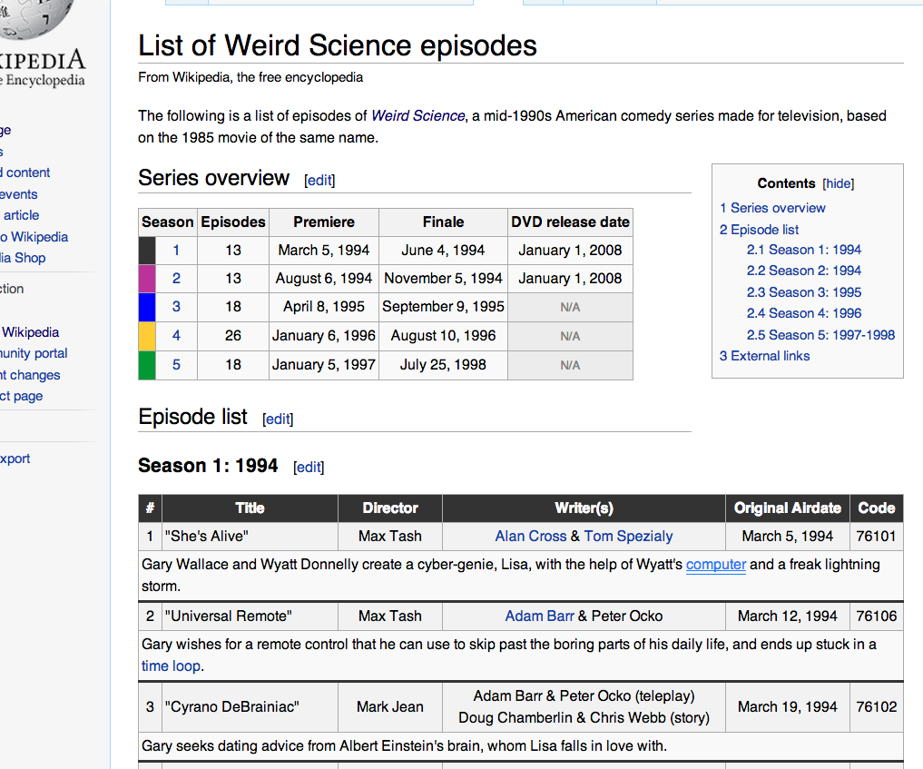
Queryable part of DBpedia is small
Back
<List of Weird Science episodes,
Director,
Max Tash>
InfoBox triples in Wikipedia
~12Million
So the rest, that is more than 80% of DBpedia is generated in this way
And most of it is not useful for structured search
Incorrect – many wrong subjects
Inconsistent (year, date, …)
Irrelevant (imageSize, width, …)

Slide 52
IBminer
More slides on

Slide 53
Extraction from Semi-structured Information
For the Semi-structured data such as tables, lists, etc. IBminer can be utilized again:
The semi-structure information should be converted to structured triple format using common patterns, and then
IBminer uses a very similar techniques to learn from the examples and convert the structured triples into the final structured knowledge using correct terminology.

Slide 54
Domain-Specific Evaluation
Back
To evaluate our system, we create an initial KB using subjects listed in Wikipedia for three specific domains*:
Musicians, Actors, and Institutes.
For these subjects, we add their related structured data from DBpedia and YaGo2 to our initial KBs.
As for the text, we use Wikipedia’s long abstracts for the mentioned subjects.
Domain | Subjects | InfoBox Triples | Sentences per Abstract
Musician | 65835 | 687184 | 8.4
Actors | 52710 | 670296 | 6.2
Institutes | 86163 | 952283 | 5.9
* Due to the limit of space, we only report results for Musicians
Notes:
To evaluate our system, we have created three data sets for domains Musicians, Actors, and Institutes from the subjects in Wikipedia.
These data sets do not share any subject, and in total they cover around 7.9% of Wikipedia subjects. We currently added Films and Locations datasets.
To build each data set, we started from a general category in the domain of the data set (e.g. Category:Musicians for Musicians data set) and find all the Wikipedia pages in this category or any of its descendant categories up to four levels.
The column with title InfoBox Triples lists the number of triples provided by DBpedia for the subjects in each set.
Institutes contains universities, colleges, famous scientists, etc.

Slide 55
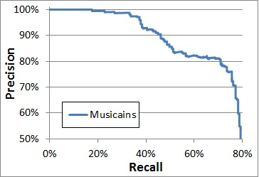
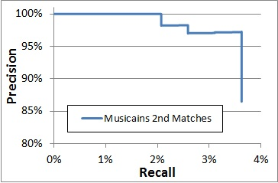
IBminer’s Results over the Musicians Long Abstracts in Wikipedia
Back
Precision/Recall diagram for the best matches
Precision/Recall diagram for secondary matches (attribute synonyms)
Notes:
The diagram on the left shows the additional improvement in the coverage of the results once the secondary matches are also conspired. (secondary matches can be seen as synonyms).
Secondary matches: In the process of generating structured from text, we first create subject-link-value from text using semscape. Then we try to match the link to one or more attribute names (encountered so far in the existing KBs.) At this point IBminer may find more than one good matches. The first or best match is always accepted (shown in the left diagram). But the other matches (called secondary matches) are accepted if there is some evidence that they are synonyms for the first/best match. (As for evidence here we use PAS as well)
The coverage in the secondary matches are computed based on the existing synonyms in the current KB which are very few and scattered.
Although the coverage shows only few percent improvement (in diagram on the right), we are finding considerable number of synonymous matches. The number of correct synonymous matches is more than half the number of best matches.

Slide 56
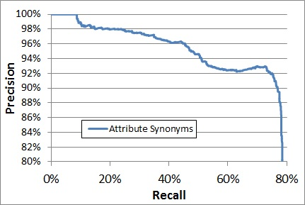
Attribute Synonyms for Existing KB
Back
Precision/Recall diagram for the attribute synonyms generated for existing InfoBoxes in the Musicians data set
Notes:
Using the learnt attribute synonyms, for each existing item in the current KBs we generated possible attribute synonyms and graded them manually.

Slide 57
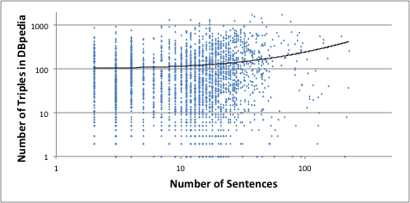
InfoBox # vs. Sentence #
Back

Slide 58
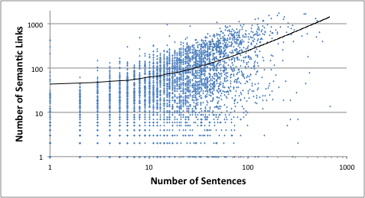
Semantic Links vs. Sentence Number

Slide 59
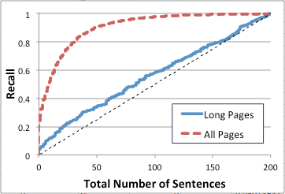
The effect of using more text

